Slide 1


CUSTOMER ANALYSIS USING TABLEAU
Presented By – MOHIT MANDE(STB03-T0016)
Guided By – Mrs. UROOJ KHAN

Slide 2

Problem Statement
Inefficient utilization of customer data hampers businesses' ability to make informed decisions. The absence of a systematic approach to analyze and visualize this data leaves organizations struggling to personalize strategies, optimize product offerings, and enhance overall customer satisfaction. This project aims to address this critical issue by leveraging Tableau to unlock actionable insights from customer data, providing businesses with the tools they need for strategic decision-making in a data-driven era.

Slide 3
Introduction
I am using Tableau to look closely at our customer data, helping us make smarter decisions.
We want to understand what our customers like, how they shop, and how we can serve them better.
Leveraging Tableau to analyze and visualize customer data for strategic decision-making.
Gaining actionable insights into customer behavior, preferences, and trends

Slide 4

Technologies Used
Software Requirements
Hardware Requirements
Tableau Public
Tableau Server
I5 processor 64 bit
4 GB Ram

Slide 5
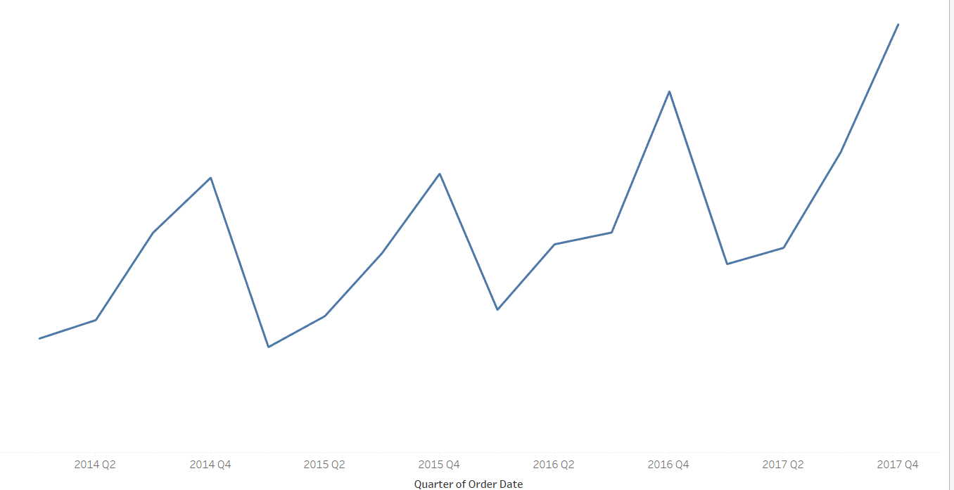
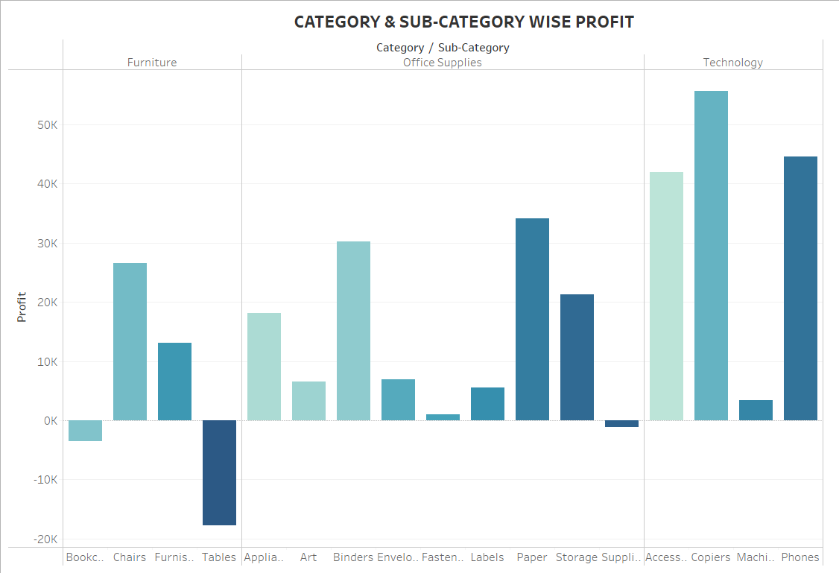
Key Metrics
Exploring customer demographics, sales patterns, and profit.
Uncovering insights to enhance customer satisfaction and drive business growth.

Slide 6
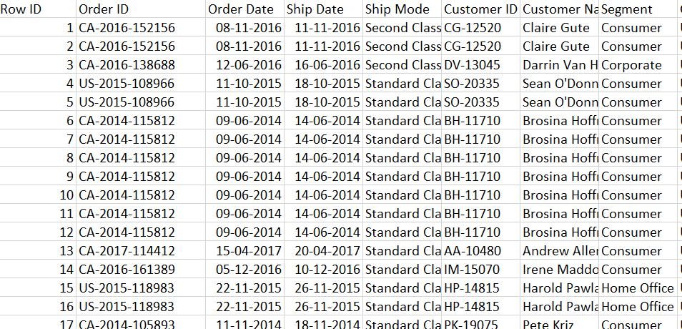
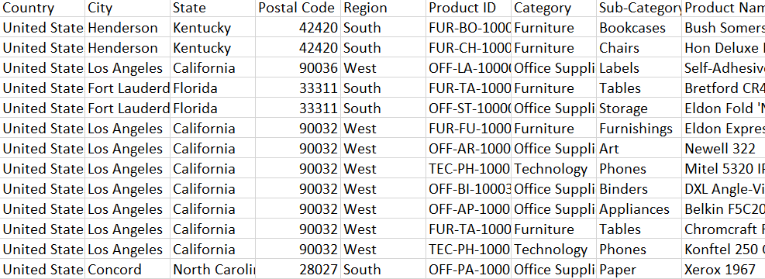
Dataset overview
Overview of the sample superstore dataset, including relevant columns like demographics, sales, profit and shipment.
Utilizing Tableau to transform raw data into meaningful visualizations.

Slide 7
methodology
Utilizing Tableau's powerful features for data exploration, visualization, and analysis.
Creating interactive dashboards to uncover trends and patterns in customer behavior.

Slide 8
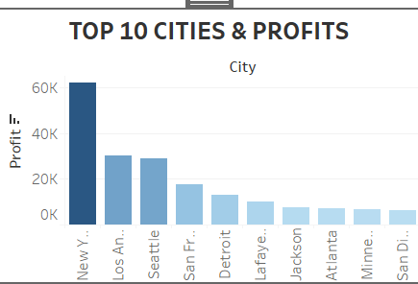
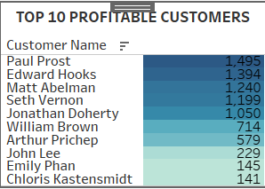
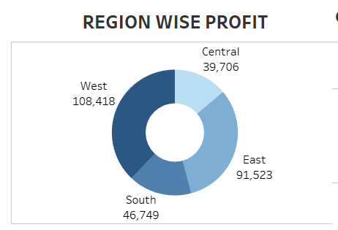
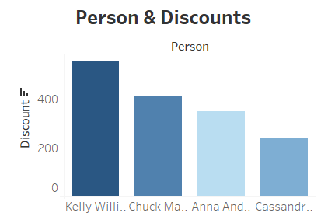
CHARTS

Slide 9
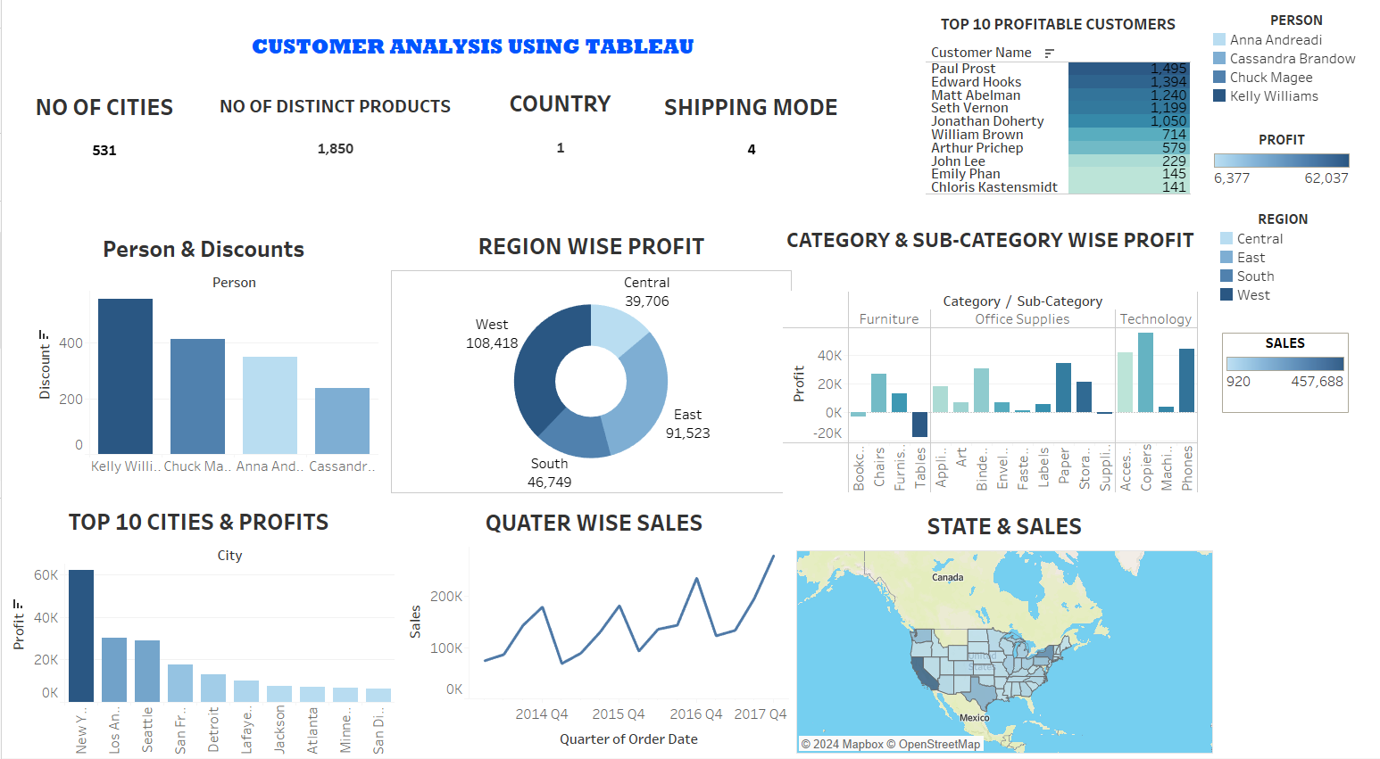
DASHBOARD

Slide 10


THANK YOU
Mohit Mande
9136875085
mandemohit4@gmail.com

